Slide 1
Efﬁcient 3D Reconstruction of Vessels from Multi-views of X-Ray Angiography
Xinglong Liu¹ Fei Hou¹ Shuai Li¹ Aimin Hao¹ Hong Qin²
1.State Key Laboratory of Virtual Reality Technology and Systems,
Beihang University, China, houfei@vrlab.buaa.edu.cn
2.Stony Brook University, Stony Brook, USA
qin@cs.sunysb.edu
Notes:
Please enter the title and authors information in this slide but do NOT change the settings of Advance Slide for this slide.
Right before your presentation starts, this slide will be shown for exactly 10 seconds. You may start speaking as soon as you arrive at the podium, or you can wait for your first slide to appear.
Right after your presentation, there will be the title slide of the next presentation, lasting 10 seconds, during which you should leave the stage allowing the next presenter to hop on and reach the podium in time.

Slide 2
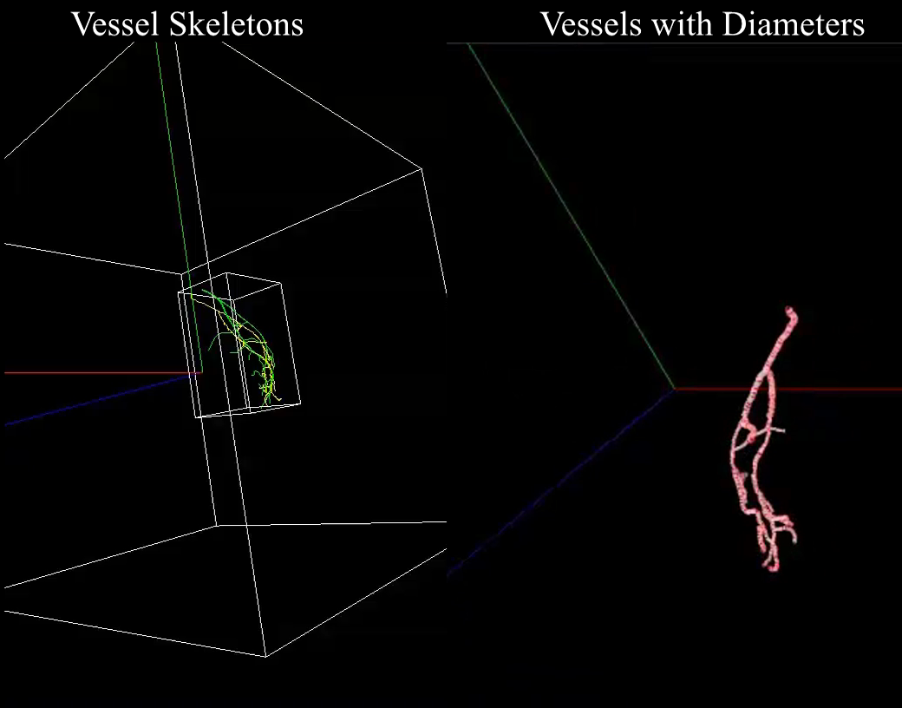
Notes:
These are the results. On the left, the green one is the ground truth and the yellow one is our result.

Slide 3
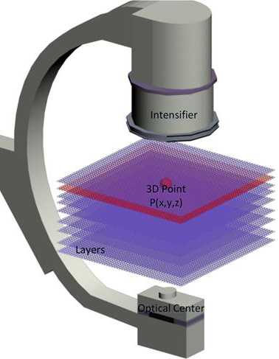
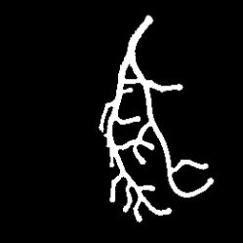
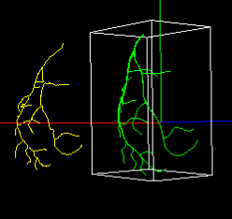
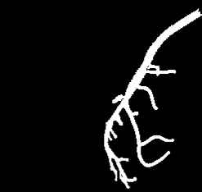
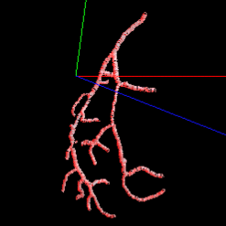
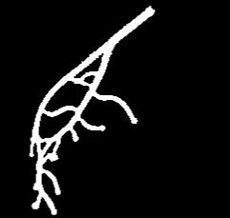
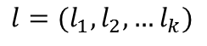

3D Reconstruction
Energy minimization
$$+$$
$$l=(l_{1},l_{2},…l_{k})$$
X-Ray Slices
Notes:
We divide the 3D space into slices. And we use three views of angiograms at the same cardiac cycle and select one as reference image $I_{1}$ .
Therefore, for a given pixel $p$ on $I_{1}$, the pair $(p, l_{i})$ uniquely identifies a point in 3D space. So, the 3D reconstruction
equals optimally assigning an label $l_{i}$ to each $p$ on $I_{1}$ .
This problem can be formulated as an energy minimization problem considering connectivity and topological structures.
We use belief propagation to solve it.

Slide 4
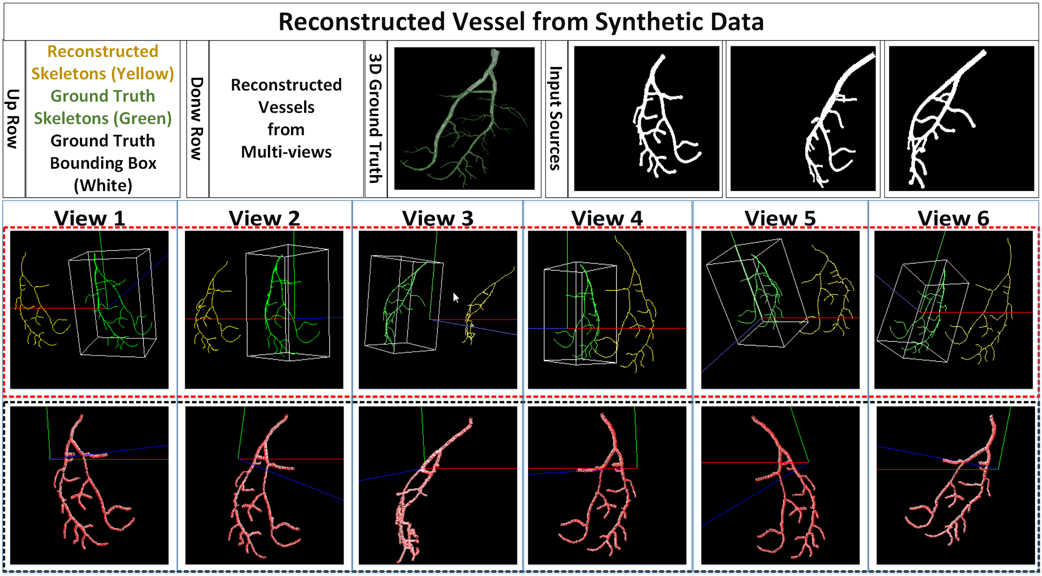
Experimental Results

Slide 5
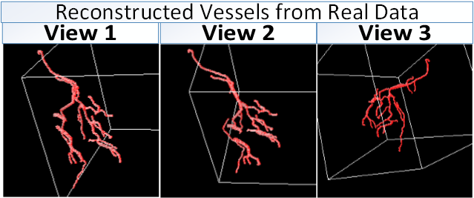
Experimental Results

Slide 6
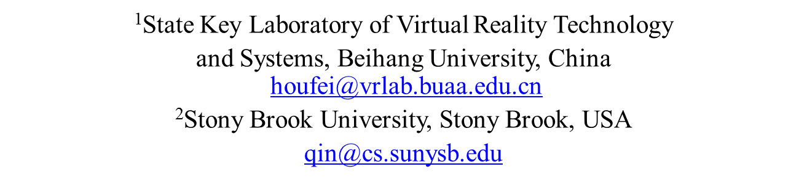
Thank You
This work is supported by National Natural Science Foundation of China (No. 61190120, 61190121, 61190125, 61300067, and 61300068) and National Science Foundation of USA (No. IIS-0949467, IIS-1047715, and IIS-1049448).
Efﬁcient 3D Reconstruction of Vessels from Multi-views of X-Ray Angiography
Xinglong Liu¹, Fei Hou¹, Shuai Li¹, Aimin Hao¹, Hong Qin²
Notes:
So, that’s all, thank you.

